Slide 1
Intro to Deep learning
Instructor: Diego Corona
The University of Manchester

Slide 2

Agenda
Introduction
Overview of PyTorch's tensor operations and automatic differentiation
The Mechanics of Deep Learning with PyTorch (120 mins)
Train a basic PyTorch model to understand the deep learning workflow.
Implement CNNs to enhance accuracy in computer vision tasks.
Apply data augmentation techniques to improve model generalisation.
Time Series Forecasting with CNNs
Break (15 mins)
Pre-trained Models and Recurrent Networks (120 mins)
Apply transfer learning to fine-tune models for personalised applications.
Train RNNs on sequential data, including a text autocompletion task
Break (15 mins)
Final Project: Object Multi-class Classification (120 mins)
Implement data generators in PyTorch to handle small datasets efficiently.
Use transfer learning and feature extraction for faster model training.
Final Review (15 mins)
Recap key learnings and answer questions.
Provide guidance on setting up a deep learning development environment.

Slide 3
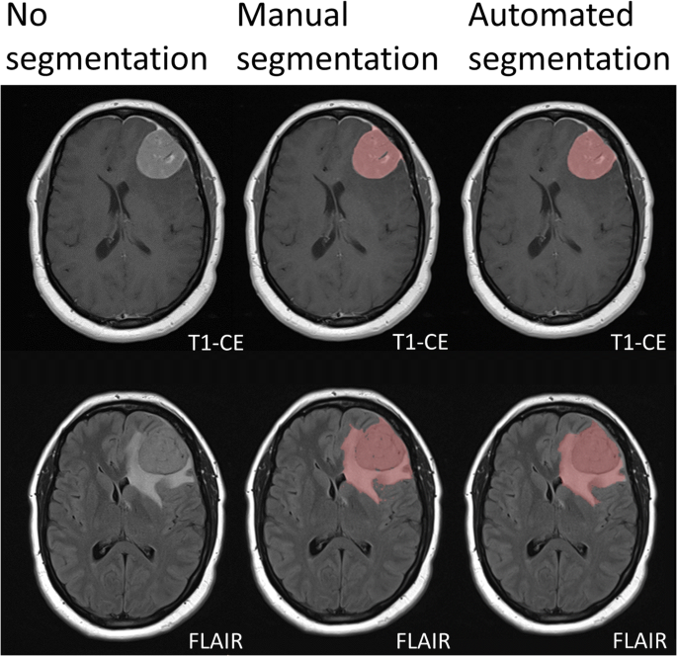
Learning from example

Slide 4
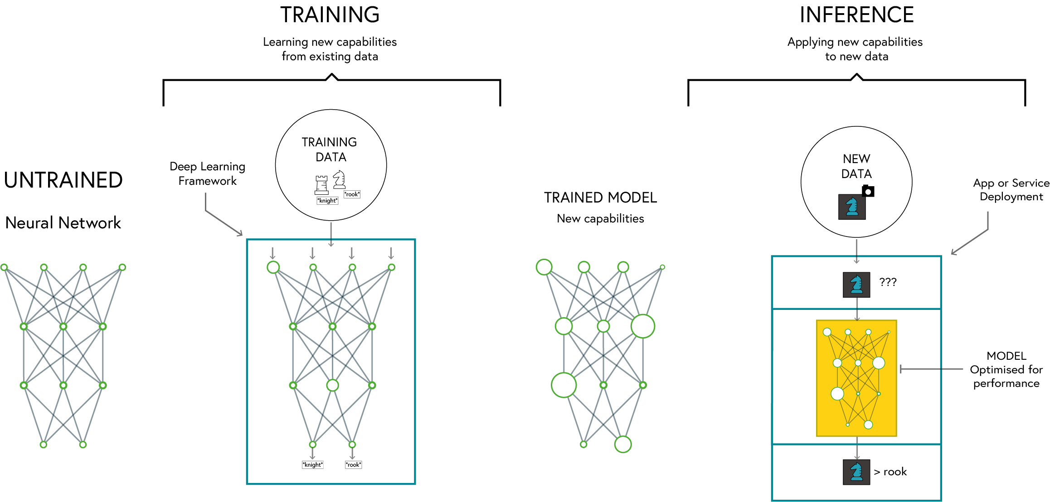
Deep learning

Slide 5

PyTorch
Dynamic Computation Graph: Easier debugging and flexible model building
Pythonic and Intuitive API: Seamless integration with Python libraries
Strong Research and Industry Adoption: Used by major companies and researchers
Excellent GPU Acceleration: Optimised for performance on GPUs and TPUs
https://pytorch.org

Slide 6
Why PyTorch
Feature | PyTorch | TensorFlow | Keras
Ease of Use | High (Pythonic, dynamic computation graph) | Moderate (Static graph by default, more setup) | Very High (High-level API)
Flexibility | High | Moderate | Low (abstracted API)
Performance | High | Very High (Optimized for deployment) | Moderate
Debugging | Easy (Eager execution) | Harder (Graph-based execution) | Easy
GPU Support | Excellent | Excellent | Good
Industry Use | Research, Prototyping | Production, Deployment | Rapid Prototyping

Slide 7
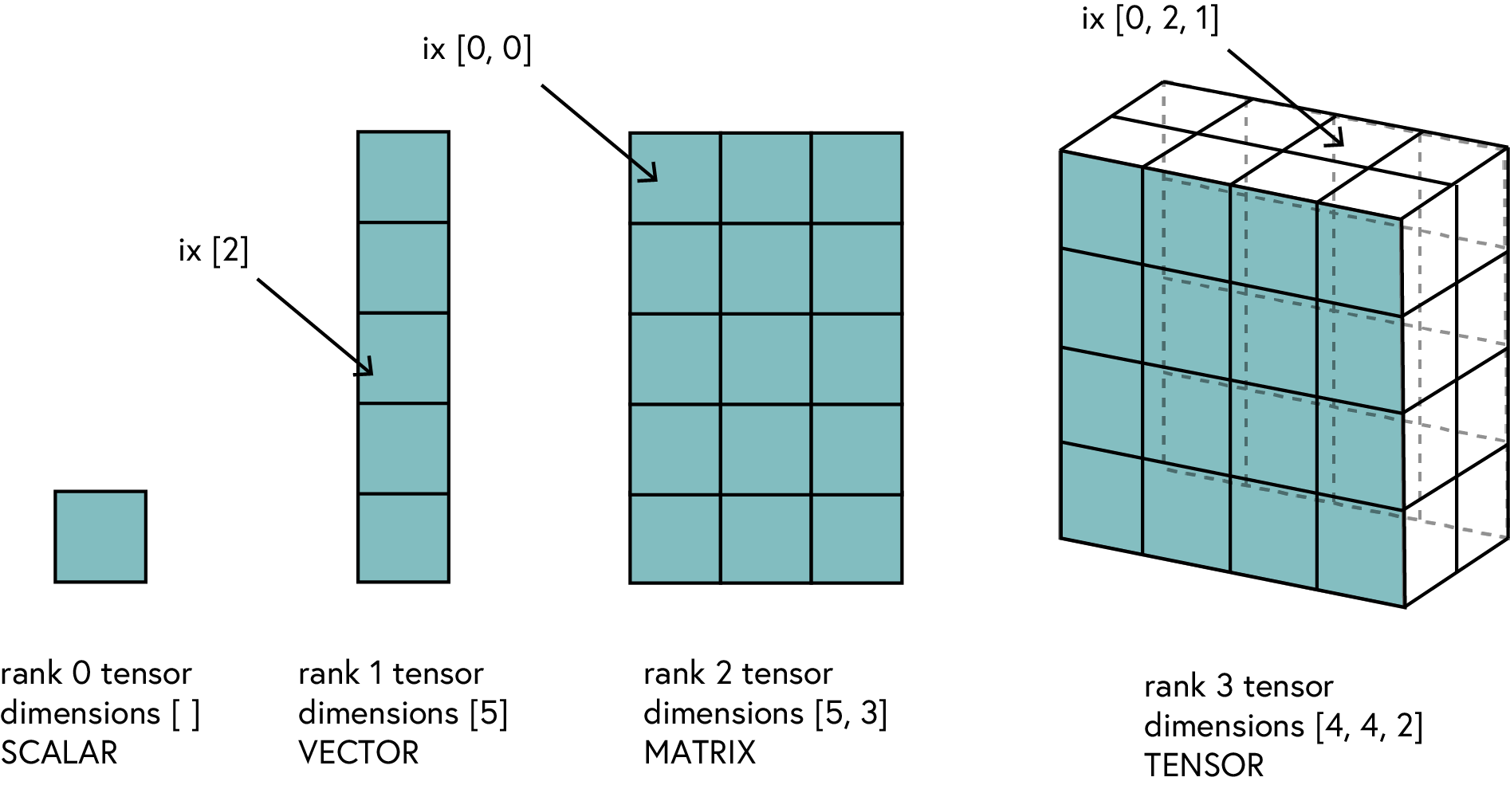
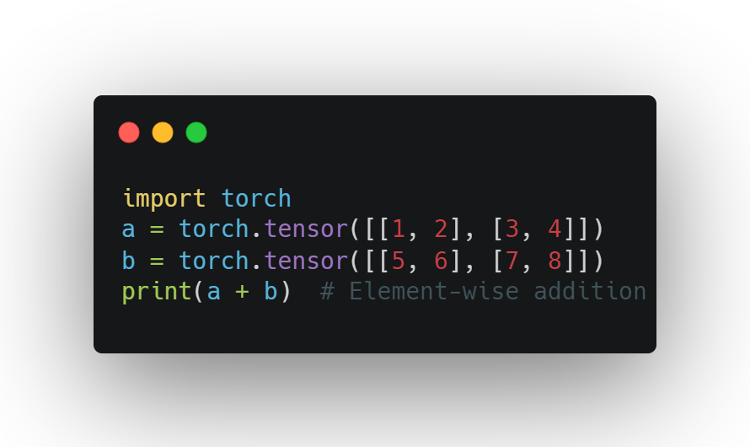
Tensors
Definition: A generalization of vectors and matrices to higher dimensions
Why Tensors?
Efficient representation of multi-dimensional data
Optimized for computation (CPU & GPU)
Basic Operations
Creating tensors
Reshaping tensors
Mathematical operations

Slide 8
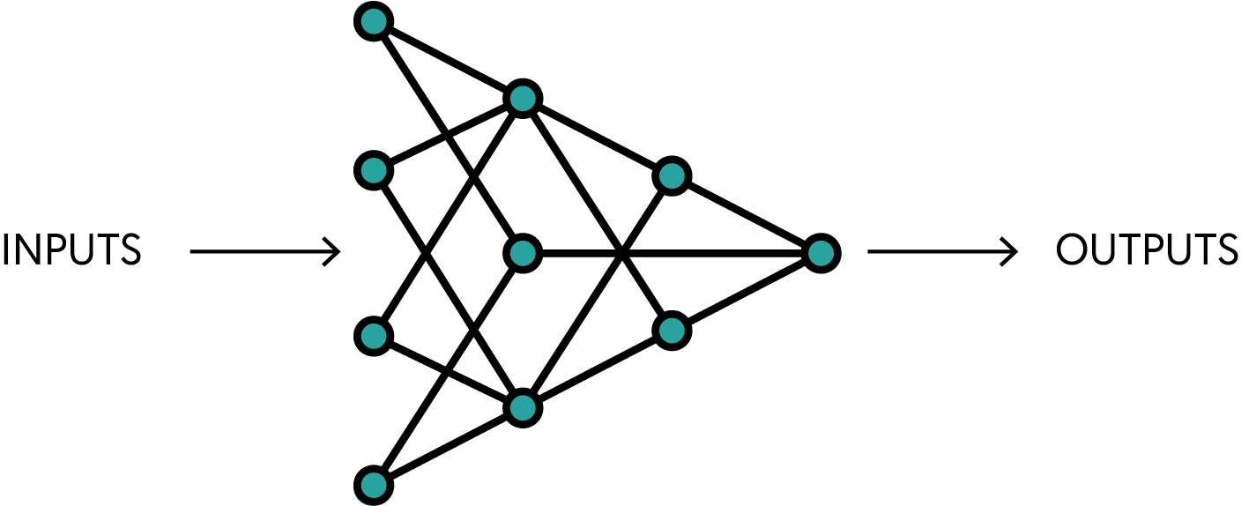
ANN
Machine Learning Models inspired by the human brain

Slide 9
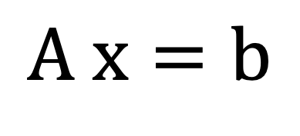
$$A x=b$$

Slide 10
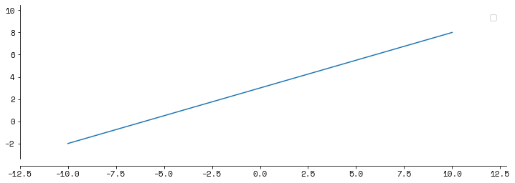
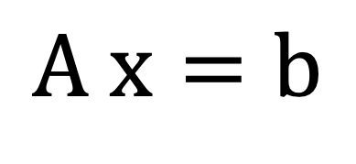
$$A x=b$$

Slide 11
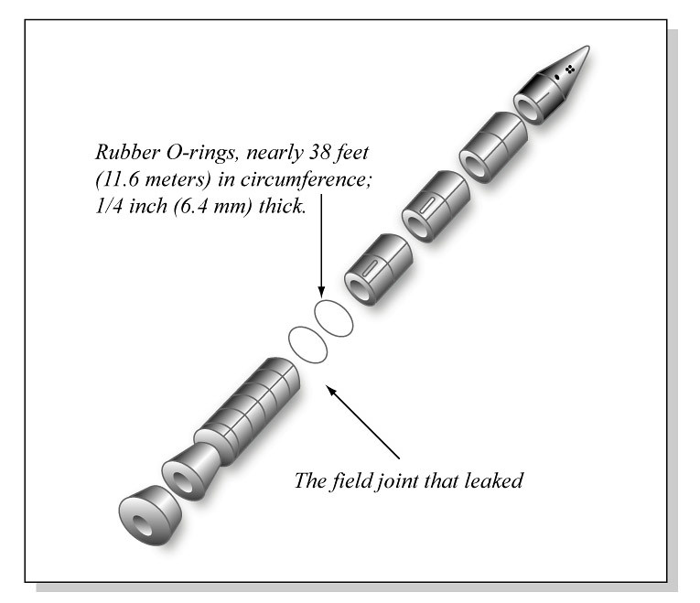

Slide 12
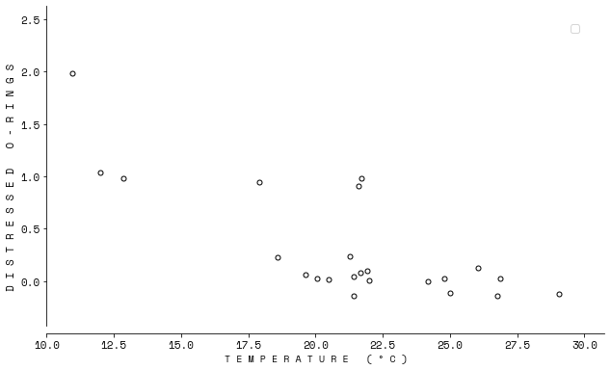

Slide 13
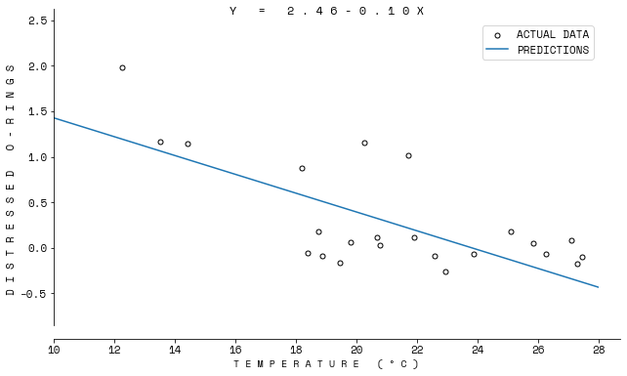

Slide 14
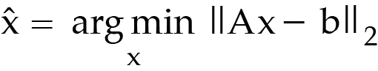

Slide 15
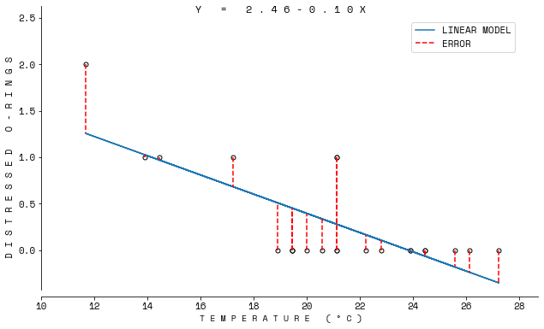

Slide 16
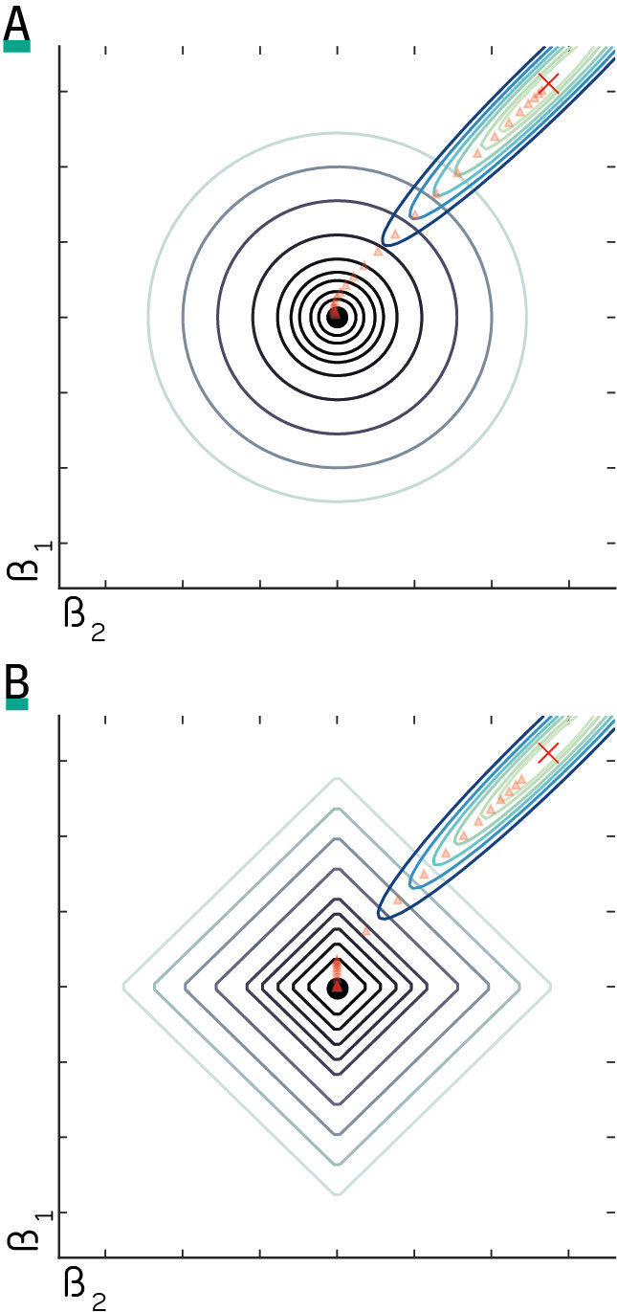

Slide 17
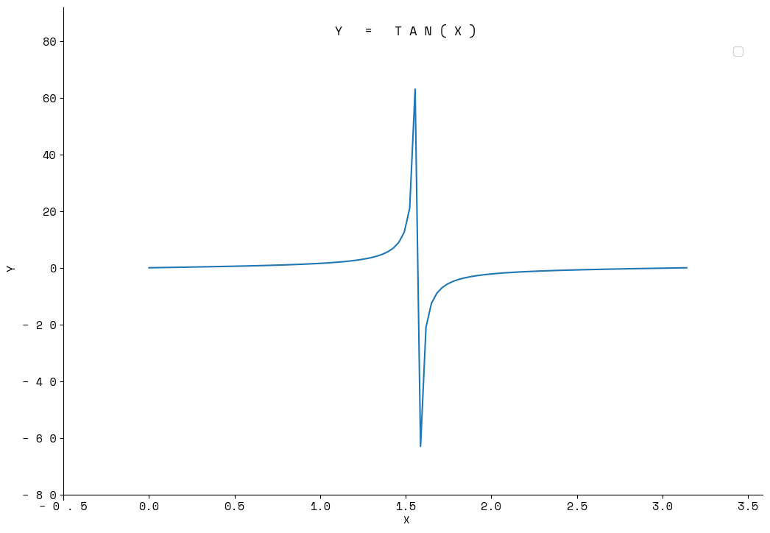

Slide 19
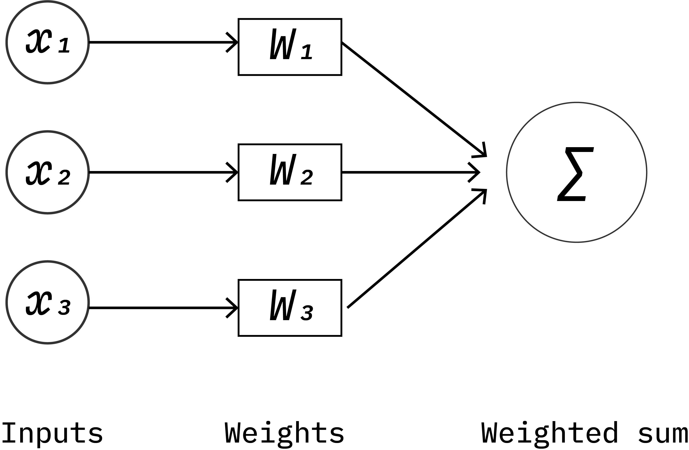

Slide 20
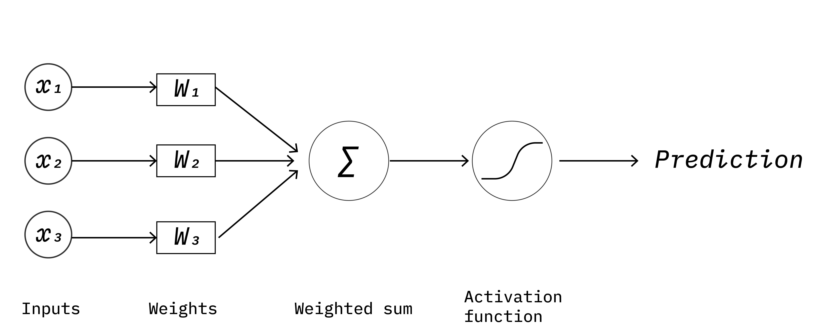

Slide 21
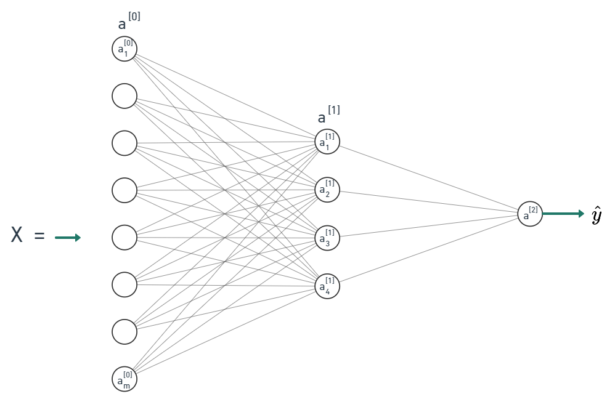

Slide 22
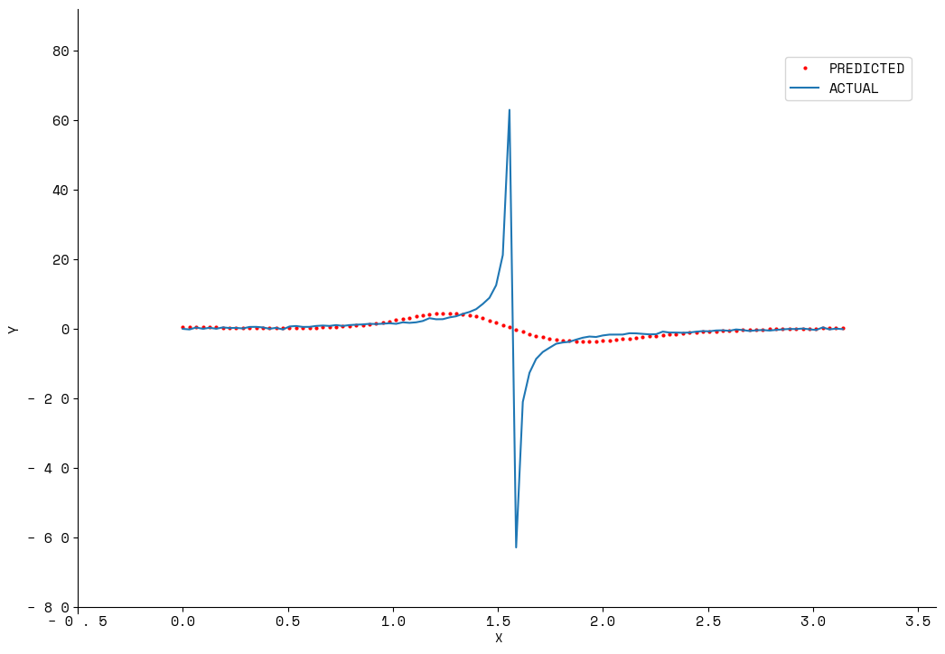

Slide 23
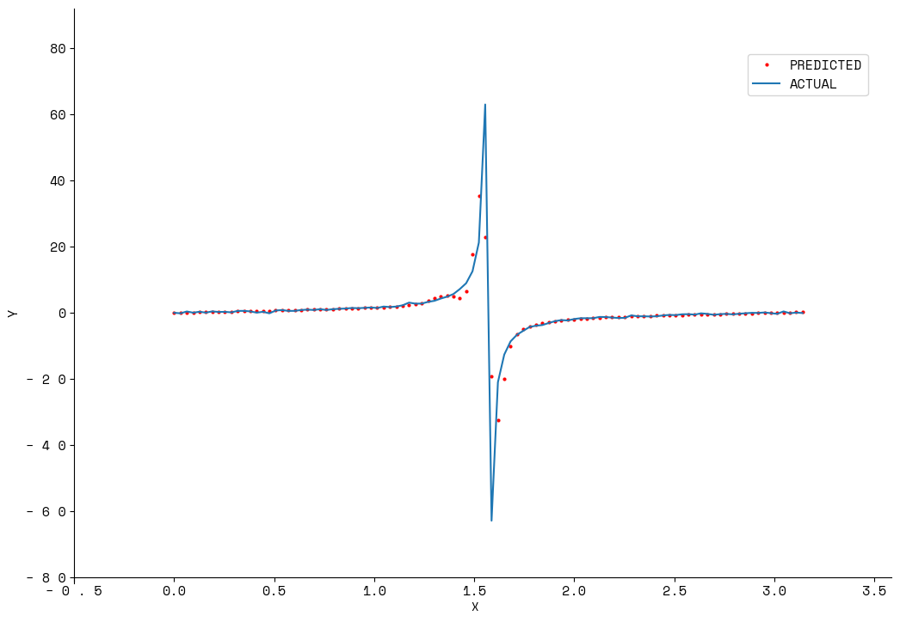

Slide 24
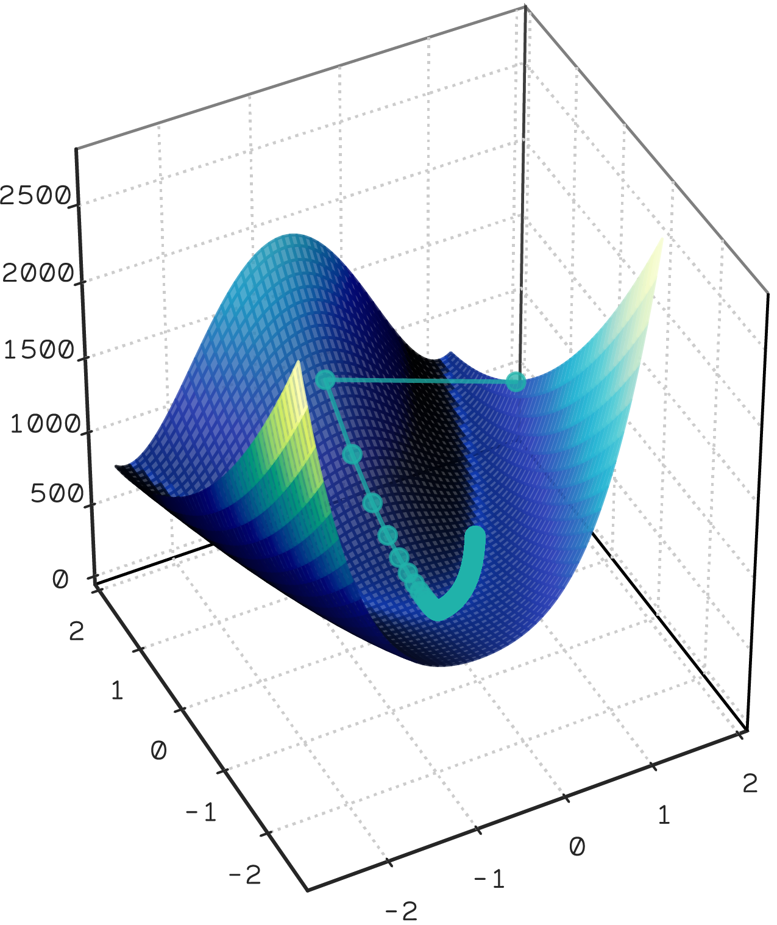

Slide 25
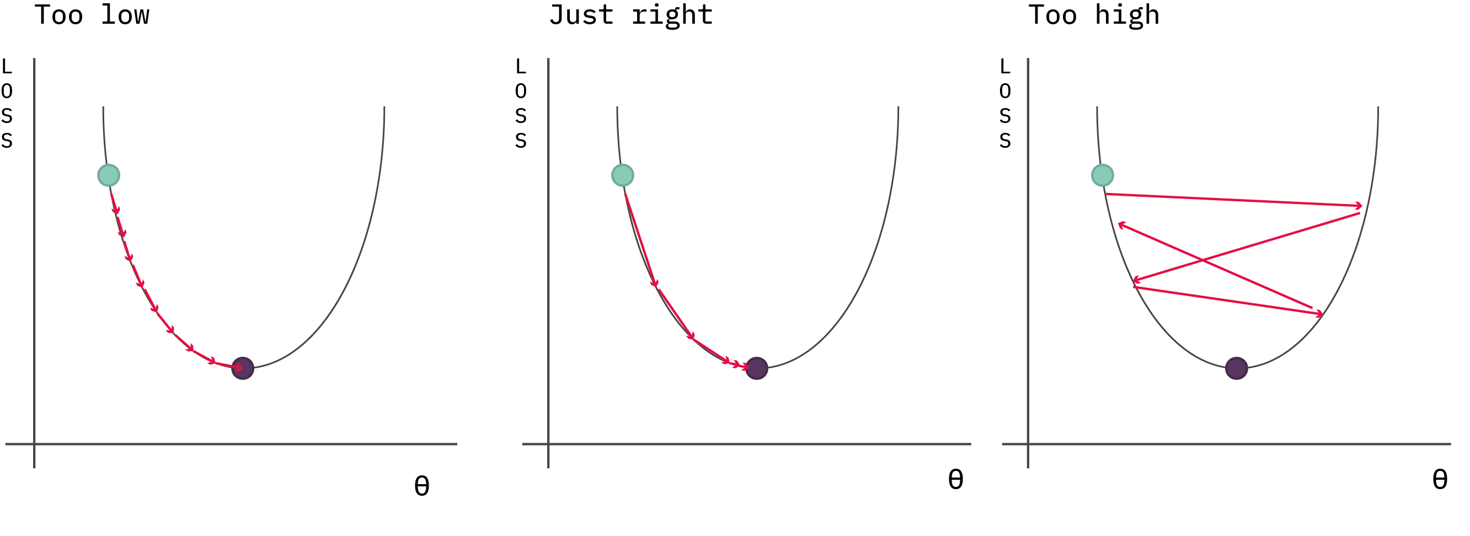

Slide 26
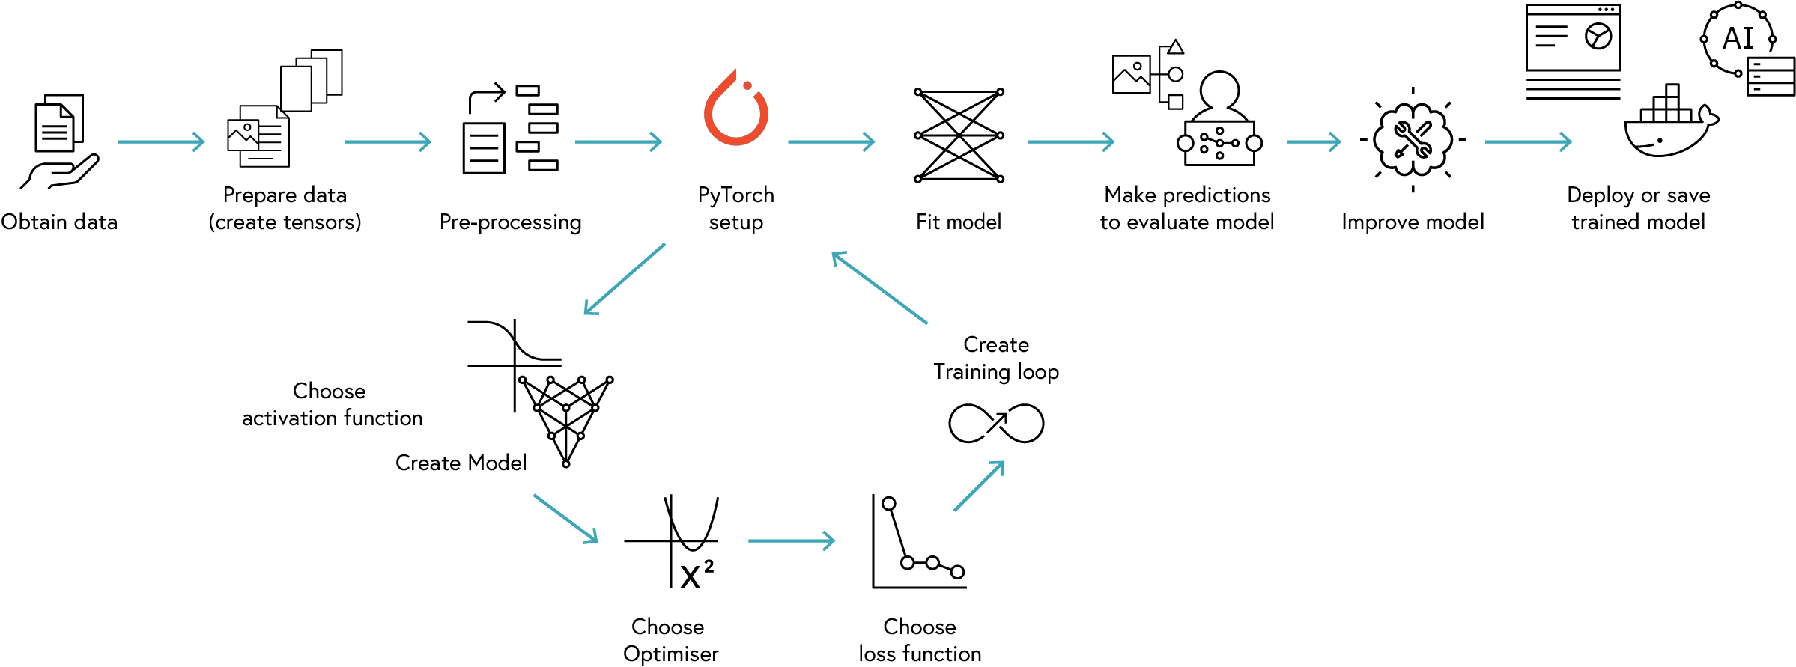
PyTorch Workflow

Slide 27
Best practices
Your delivery can make or break your presentation. Focus on the following techniques.
Normalization
Vary pitch, tone, and volume to emphasize key points. Pause strategically as silence builds anticipation.
Train, Validation, and Test split
Maintain open gestures and avoid crossing your arms. Move naturally. Step forward when making a strong point.
Batches
Look for cues (like nodding and note-taking) that show that your audience is engaged.
Additional tips
Be confident, rehearse aloud, and show enthusiasm.

